Slide 1

Fundamentals of Electrical Engineering
By
Dr. Eman Ahmed Awad Megahed
First YEAR
Dr : Eman A. Awad

Slide 2
Course contents
CH1
CH2
CH3
CH4
CH5
CH6
Units and Basic Concepts
Resistance and Ohm’s Law
Series and Parallel DC Circuits
DC Circuit Analysis
CH7
Capacitor and Capacitance
Inductor and Inductance
DC Equivalent Circuits, Network Theorems and Bridge Circuits
Dr : Eman A. Awad

Slide 3
Course contents
CH8
CH9
CH10
CH11
Sinusoidal Alternating Voltage and Current
Basic AC Circuits Analysis
AC Circuits Under Steady State
CH12
Power in AC Circuits
AC Equivalent Circuits, Network Theorems and Bridge Circuits
Dr : Eman A. Awad

Slide 4
Units and Basic Concepts
Chapter 1
Dr : Eman A. Awad

Slide 5
Chapter Content
CH1: Units and Basic Concepts
International System of Units
Electric Charge
Electric Current
Voltage
Dependent Sources
Power
Energy
E. A. MEGAHED
Dr : Eman A. Awad

Slide 6
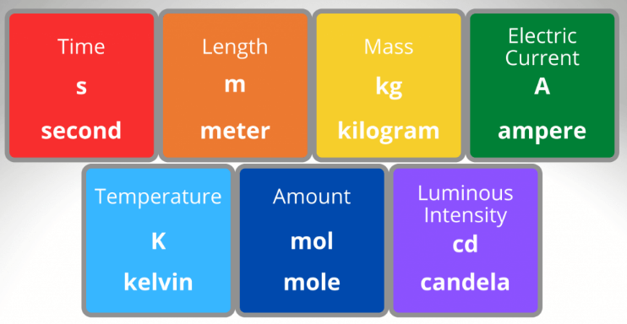
1. International System of Units
The international system of units (SI) is the international measurement language.
SI has nine base units, units of all other physical quantities are derived from these units.
نظام القياس الدولي به عدد 9 وحدات الاساسية وباقي الوحدات للكميات الفيزيائية منشقة من هذه الوحدات
Dr : Eman A. Awad

Slide 7
1. International System of Units
This system differs considerably from the more British system in which we measured:
Length: Yards, Feet, Inches Mass: Pound
Power: Horsepower Temperature: Degree Fahrenheit
SI system has one important advantage, there is one and only one unit for each physical quantity.
Another advantage is a unique and well defined set of symbols:
Ampere (A), Kilogram (Kg), Meter (m)
Dr : Eman A. Awad

Slide 8
1. International System of Units
There is a decimal relation among multiples and submultiples of each base unit .For example:
Kilo: one thousand Kilometer= 1000 meter
Centi: 10^-2 Centimeter=0.01 meter
Micro: 10^-6 Microampere= 10^-6 Ampere
Mega: 10^6
Milli: 10^-3
Nano: 10^-9 , Pico: 10^-12
Dr : Eman A. Awad

Slide 9
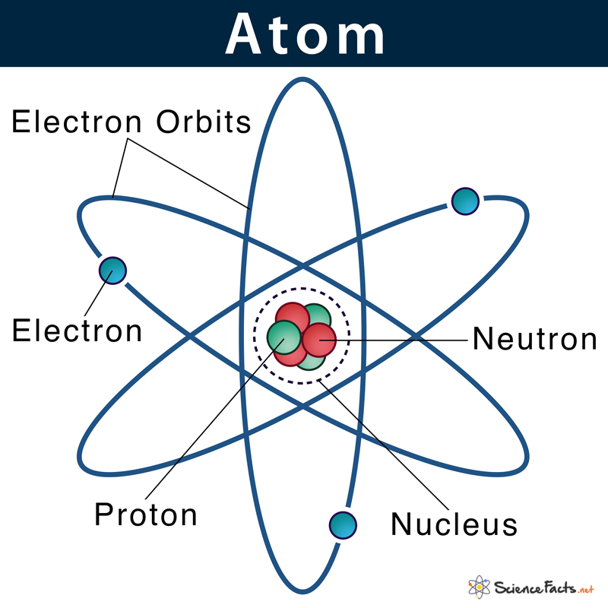
2. Electric Charge
Each atom consists of a very small nucleus composed of protons and neutrons and is encircled by moving electrons.
Nucleus of atom is positively charged.
The charge on the electron is equal and opposite to the charge on the proton.
The charge of an electron is 1.6022 × 10^−19 C
The unit of charge is called Coulomb (C)
The number of positive and negative charges are equal, hence matter is basically neutral.
Dr : Eman A. Awad

Slide 10
2. Electric Charge
There are two types of charges. +ve and –ve. Similar charges repel each other, Opposite charges attract each other.
The charge quantity symbol is Q or q (Q for constant charge, q for charge varies with time.
A body acquires +VE charge, if it has deficiency of electrons as compared to the number of protons.
A body acquires –VE charge if it has excess of electrons as compared to the protons.
Electric charge is an integral multiple of minimum charge (e).
Charge on a body Q is given by: Q = + n× e , Where n is a whole number 1,2,3….. and e = 1.6 x 10^-19.
Dr : Eman A. Awad

Slide 11
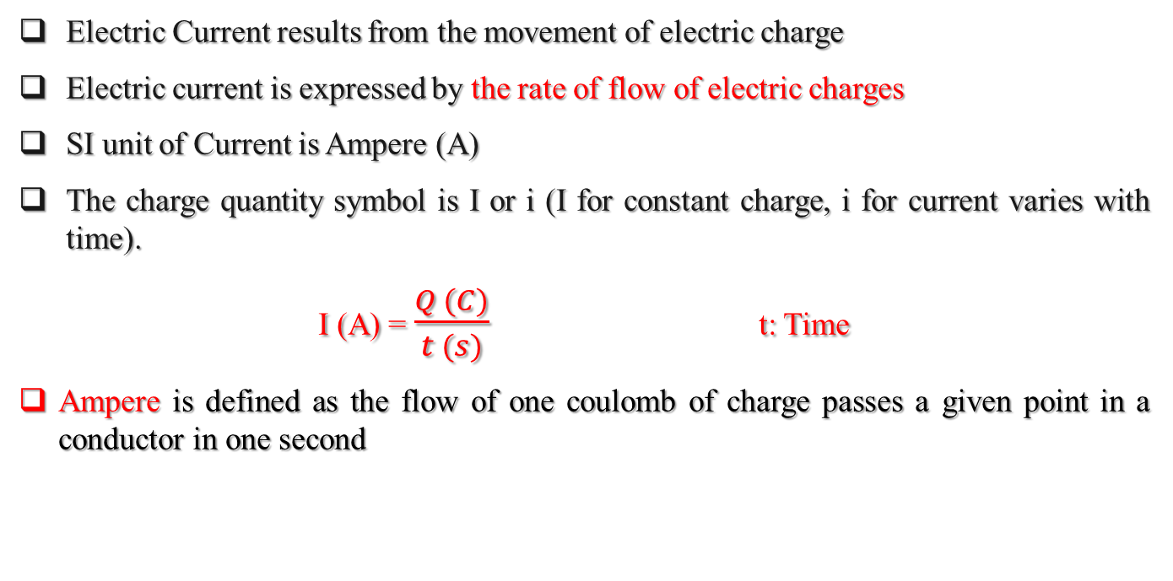
2. Electric Current
Electric Current results from the movement of electric charge
Electric current is expressed by the rate of flow of electric charges
SI unit of Current is Ampere (A)
The charge quantity symbol is I or i (I for constant charge, i for current varies with time).
I (A) = $\frac{Q (C)}{t (s)}$ t: Time
Ampere is defined as the flow of one coulomb of charge passes a given point in a conductor in one second
Dr : Eman A. Awad

Slide 12
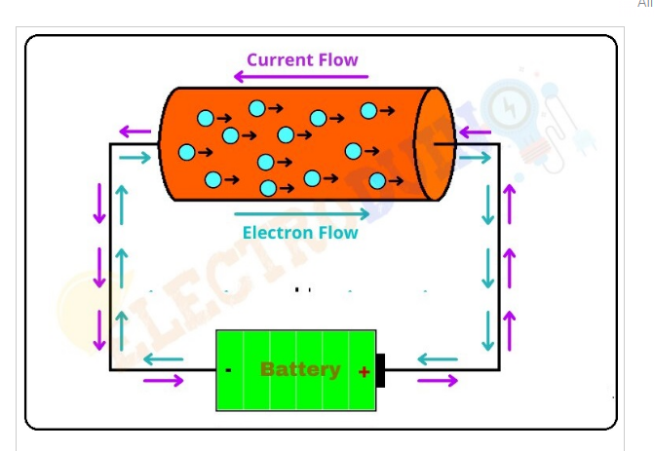
3. Electric Current
If the electrical charge flows through a conductor (metallic wire), we say that there is an electric current in the conductor.
In circuits using metallic wires, electrons constitute the flow of charges, the direction of electric current is taken as opposite to the direction of the flow of electrons, which are negative charges.
Dr : Eman A. Awad

Slide 13
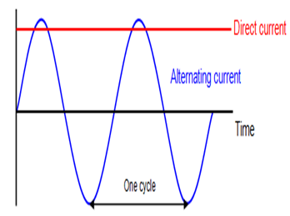
3. Electric Current
Direct Current: current that flows in only one direction all the time
Usually, direct current (DC) refers only to a constant current.
Alternative Current: current that alternates in direction of flow
Usually, alternating current (AC) refers to a current that varies sinusoidal with time.
Dr : Eman A. Awad

Slide 14
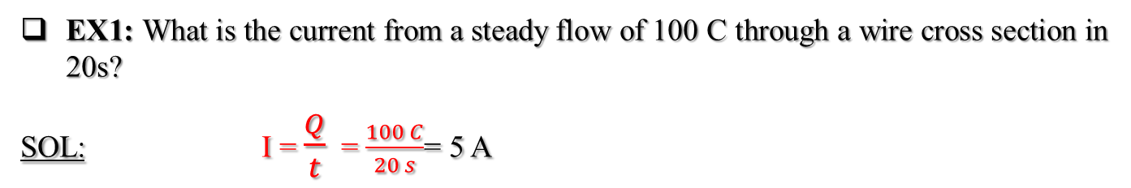
EXAMPLES
EX1: What is the current from a steady flow of 100 C through a wire cross section in 20s?
SOL: I = $\frac{Q}{t}$ = $\frac{100 C}{20 s}$= 5 A
EX2: An element in a circuit that can stores charge, what is the charge stored on the element from a steady current of 2A for 100 µs?
SOL: Q = I * t = 2 A* 100 * 10^(-6) =200 µC
Coulomb = Ampere × Second
Dr : Eman A. Awad

Slide 15
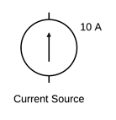
3. Electric Current
Current Source: is a circuit element that provides a specified current
The figure shows the circuit diagram symbol for a current source, this source provides 10 A current in the direction of the arrow.
Electrical Circuit: A circuit is a closed path around which current flows or electron moves.
Dr : Eman A. Awad

Slide 16
4. Voltage
Moving an object against a force that oppose the motion is called Work.
Ex: Lifting something against the force of gravity.
Work: is the product of the force and the distance moved.
SI unit of Work (W) is Joule (J)
SI unit of Force (F) is Newton (N)
W (Joule) = F (Newton) × d (Meters)
Energy: is the capacity to do work
One of its forms is Potential Energy or Kinetic Energy
Dr : Eman A. Awad

Slide 17
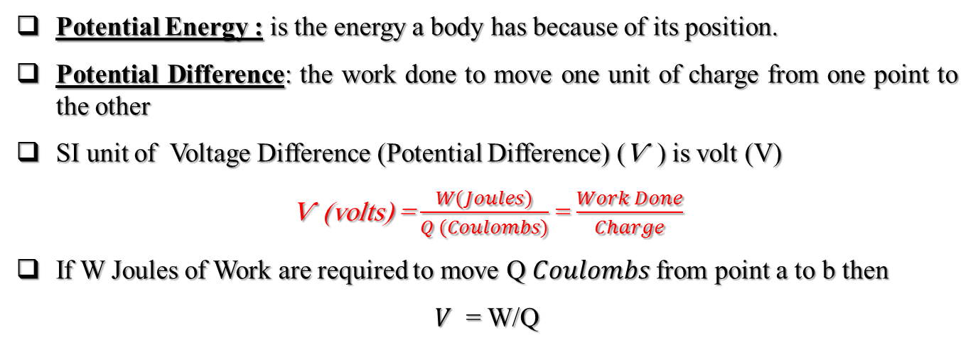
4. Voltage (Potential Difference)
Potential Energy : is the energy a body has because of its position.
Potential Difference: the work done to move one unit of charge from one point to the other
SI unit of Voltage Difference (Potential Difference) (Ѵ ) is volt (V)
Ѵ (volts) = $\frac{W(Joules)}{Q (Coulombs)}$ = $\frac{Work Done}{Charge}$
If W Joules of Work are required to move Q 𝐶𝑜𝑢𝑙𝑜𝑚𝑏𝑠 from point a to b then
$V$ = W/Q
Dr : Eman A. Awad

Slide 18
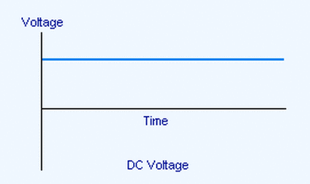
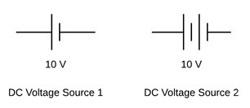
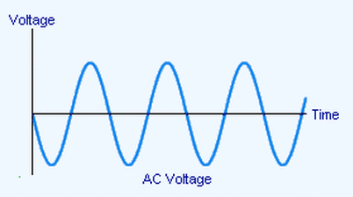
4. Voltage (Potential Difference)
DC Voltage: is a constant voltage.
AC Voltage: is a voltage varies with time
Voltage Source: such as a battery (DC) or generator (AC)
Dr : Eman A. Awad

Slide 19
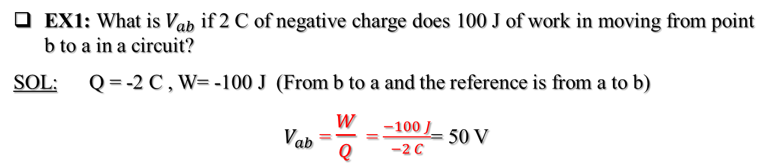
EXAMPLES
EX1: What is $V_{ab}$ if 2 C of negative charge does 100 J of work in moving from point b to a in a circuit?
SOL: Q = -2 C , W= -100 J (From b to a and the reference is from a to b)
$V_{ab}$ = $\frac{W}{Q}$ = $\frac{−100 J}{−2 C}$= 50 V
Dr : Eman A. Awad

Slide 20
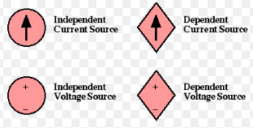
5. Dependent Source
Independent Source (Current): is a current source that provides a certain amount of current.
Independent Source (Voltage): : is a voltage source that provides a certain amount of voltage.
Dependent Source: Also called a controlled source, is a voltage/current source that provides a voltage or a current that depends on voltage or current elsewhere in a circuit.
A dependent source is designated by
a diamond shaped symbol.
Dr : Eman A. Awad

Slide 21
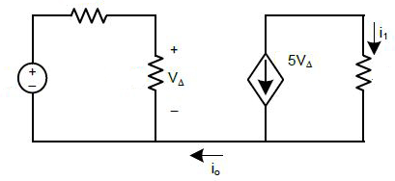
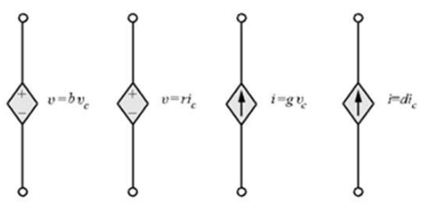
5. Dependent Source
The circuit contains a dependent voltage source that provides a voltage of 5VA which is five times the voltage VA across the resistor.
There are four types of dependent sources:
Voltage controlled voltage source
Current controlled voltage source
Voltage controlled current source
Current controlled current source
Dr : Eman A. Awad

Slide 22
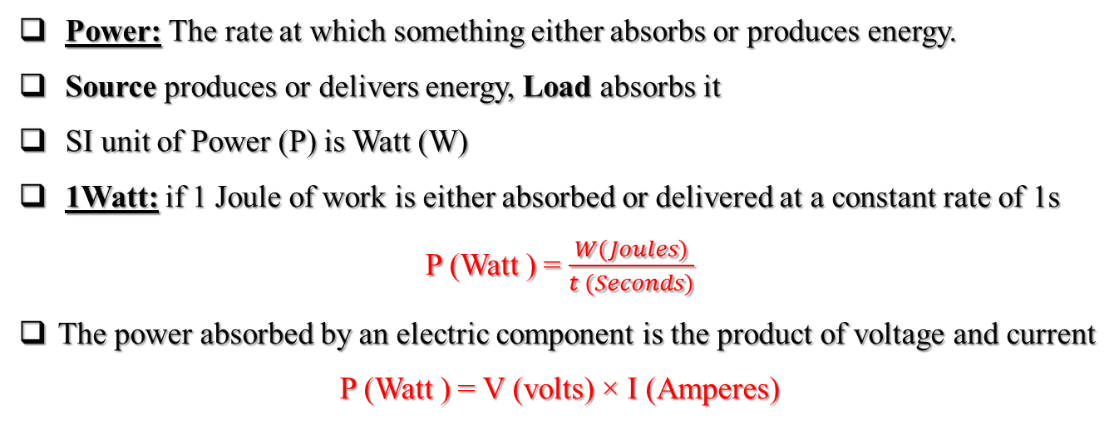
6. Power
Power: The rate at which something either absorbs or produces energy.
Source produces or delivers energy, Load absorbs it
SI unit of Power (P) is Watt (W)
1Watt: if 1 Joule of work is either absorbed or delivered at a constant rate of 1s
P (Watt ) = $\frac{W(Joules)}{t (Seconds)}$
The power absorbed by an electric component is the product of voltage and current
P (Watt ) = V (volts) × I (Amperes)
Dr : Eman A. Awad

Slide 23
6. Power
If the calculated power is positive , the component actually absorbed power.
If the calculated power is negative , the component actually produces power.
The power output is expressed by a unit called Horsepower (hp)
The relation between watt and horsepower 1hp= 475.7 W
Electrical Energy: is the product of the electrical power input or output and the time over which this input or output occurs
W (Joules ) = P (Watts) × t (Seconds)
Dr : Eman A. Awad

Slide 24
6. Power
The companies use as an energy unit Kilowatt-hour (KWh)
W (Kilowatt-hour (KWh)) = P (Kilowatt) × t (Hour)
EX5: How many joules are equivalent to 1 kilowatt-hour?
SOL: 1 KWh = 1000 W × 60 min × 60 s = 1000 W × 3600 s= 3 600 000 W.s =
3 600 000 J = 3.6 M Joule
EX6: What is the energy absorbed by a component that absorbs 10W for 2 min?
SOL:
W= P ×t = 10 × 2 × 60 = 1200 W.s = 1200 Joule
Dr : Eman A. Awad

Slide 25

7. Efficiency
Efficiency: is based on work or power output divided by work or power input
Efficiency is usually expressed as a decimal fraction that is the percentage divided by 100.
Efficiency (η ) = $\frac{power output (P_{out})}{power input (P_{in})}$ × 100%
Dr : Eman A. Awad

Slide 26
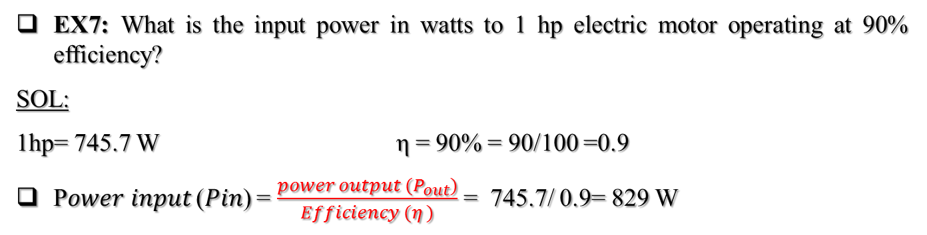
EXAMPLES
EX7: What is the input power in watts to 1 hp electric motor operating at 90% efficiency?
SOL:
1hp= 745.7 W η = 90% = 90/100 =0.9
P𝑜𝑤𝑒𝑟 𝑖𝑛𝑝𝑢𝑡 (𝑃𝑖𝑛) = $\frac{power output (P_{out})}{Efficiency (η )}$ = 745.7/ 0.9= 829 W
Dr : Eman A. Awad

Slide 27
End of Lecture 1
Dr : Eman A. Awad

